Slide 2
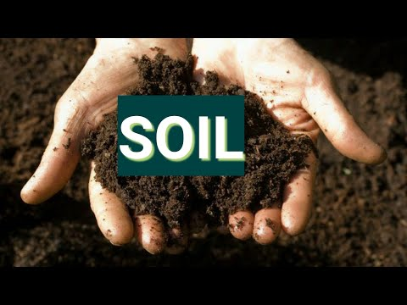
CONTENTS: SOIL FORMATION TYPES OF SOIL 1. ALLUVIAL SOIL 2. RED SOIL 3. BLACK SOIL 4. LATERITE SOIL 5. MOUNTAIN SOIL 6. DESERT SOIL SOIL EROSION AND CONSERVATION
7.OUR SOILS

Slide 3
SOIL IS FORMED WHEN LARGE ROCKS BREAK INTO SMALLER PIECES.
SOIL FORMATION

Slide 4
TYPES OF SOIL
CHAPTER 7/KARUNAMBIGAI/SOCIAL DEPT/SNS ACADEMY

Slide 5
VIDEO OF SOIL
https://youtu.be/4aB3PbWUpqY
Chapter 4/social/karunambigai/Sns Academy

Slide 6
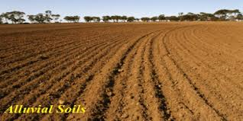
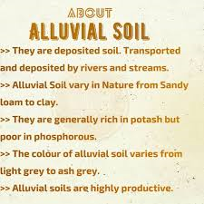
.
ALLUVIAL SOIL

Slide 7
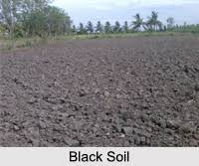
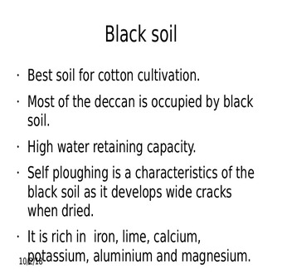
BLACK SOIL

Slide 8
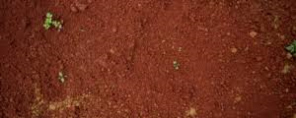
RED SOIL

Slide 9
LATERITE SOIL

Slide 10
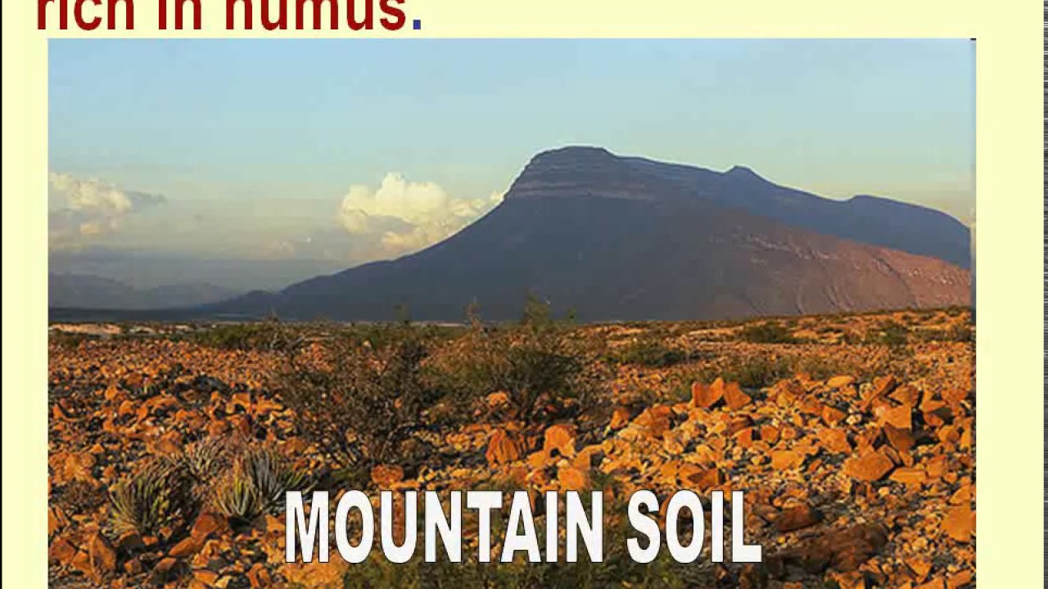
The mountail soil is a highly leached soil which is acidic in nature and is poorly fertile too. its is found in Jammu and Kashmir,UP, West Bengal in Himalyas submontane tracts.It is also found in the himalyas , north eastern hills and other mountains. It is rich in Humus.
MOUNTAIN SOIL

Slide 11
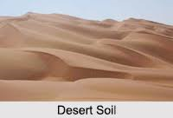
.
DESERT SOIL

Slide 12
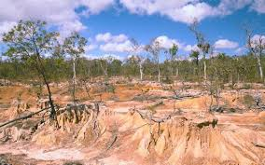
The removal of top soil by rainwater and wind is called Soil erosion. CAUSES OF SOIL EROSION Running water is the leading cause of soil erosion, because water is abundant and has a lot of power. Wind is also a leading cause of soil erosion because wind can pick up soil and blow it far away. Activities that remove vegetation, disturb the ground, or allow the ground to dry are activities that increase erosion
Soil Erosion
.

Slide 13
SOIL CONSERVATION 1.DO NOT CUT TREES. 2.PLANT MORE TREES 3.DO NOT KEEP THE FIELD BARREN. 4.STOP OVERGRAZING OF LAND. 5.USE MANURE OR NATURAL FERTILIZERS INSTEAD OF ARTOFICIAL FERTILIZERS.
.

